Slide 1

SURGICAL INSTRUMENTS DATA BASE
Celia Martín Cubillo
Rosario Ferrer Pérez-Blanco
Pablo Ligero Isla
Alejandro Pastrana San Martín

Slide 2

Why surgical instruments?
Biomedical application
Hospitals orders
Manufacture of instruments
Accurate and easy access to variables

Slide 3
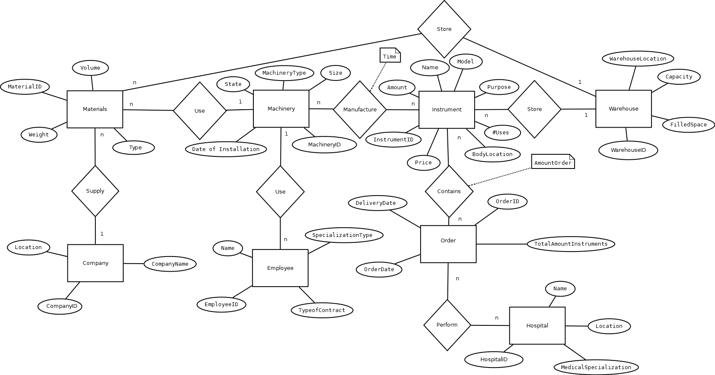
E–R Diagram

Slide 4
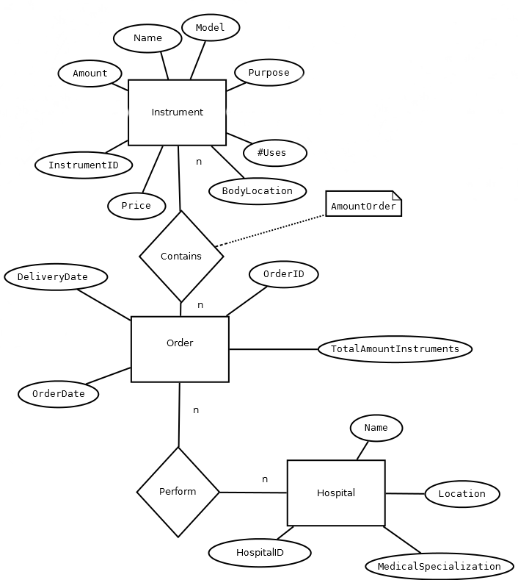


Hospital
HOSPITAL
Hospital ID | Medical Specialization | Location | Name
1 | General | Madrid | HM
2 | Traumatology | Cadiz | San Fernando
3 | General | Madrid | La Paz
Order
ORDER
ID Order | Order Date | Delivery Date | Total Amount of Instruments
1 | 01/01/2017 | 01/02/2017 | 30
2 | 02/01/2017 | 02/02/2017 | 100
3 | 03/01/2017 | 03/06/2017 | 200

Slide 5


Instrument
Instrument - Order
INSTRUMENT
ID Instrument | Name | Model | Purpose | Amount | # Uses | Body Location | Price | Warehouse Location
1 | Scalpel | Version1 | Cut | 5 | 500 | General | $12 | Chamberi Street nº6
2 | Saw | Version2 | Clean | 6 | 1 | General | $5 | Oxfordi Street nº55
3 | Scissors | Version1 | Absorb | 7 | 200 | Stomach | $200 | Alcala Street nº16
INSTRUMENT-ORDER
ID Instrument | ID Order | AmountOrder
1 | 1 | 200
3 | 1 | 500
2 | 3 | 342
Hospital - Order
HOSPITAL - ORDER
Hospital ID | ID Order
1 | 1
2 | 1
1 | 3

Slide 6
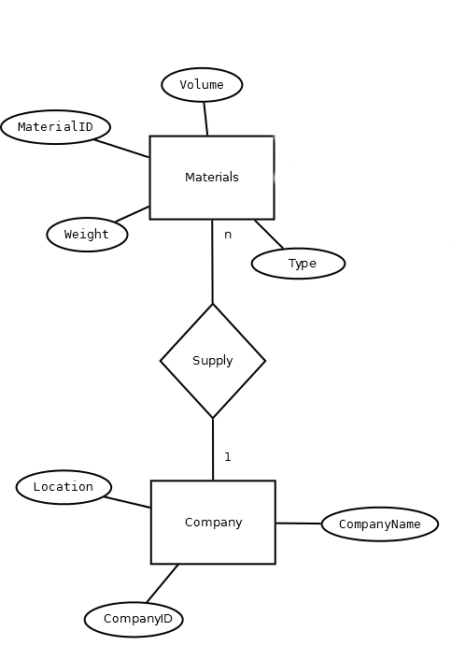

Company
COMPANY
Company ID | Localization | Company Name
1 | Madrid | BCC

Slide 7


Materials
Machinery
MachineryID | MachineryType | State | Date of installation | Size
1 | Laser | No Working | 1/1/17 | 2.2m^2
2 | Sterilization | Working | 2/1/17 | 4m^2
3 | Grinder | Working | 3/1/17 | 3m^2

Slide 8
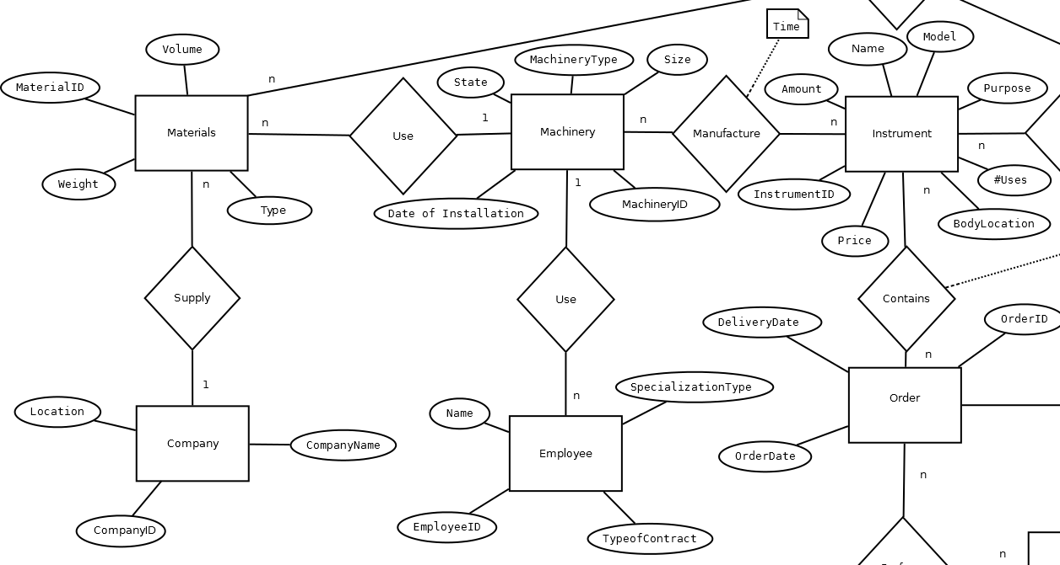

INSTRUMENT - MACHINERY
ID Instrument | Machinary ID | Time
1 | 1 | 5h
1 | 2 | 1h
2 | 3 | 2h
EMPLOYEE
Employee ID |  | Name | Type of Contract | Specialization Type | Machinery Type
1 |  | Maria | Temporal | Laser | Laser
2 |  | Pepe | Permanent | Grinder | Sterilization
3 |  | Juan | Permanent | Grinder | Grinder

Slide 9

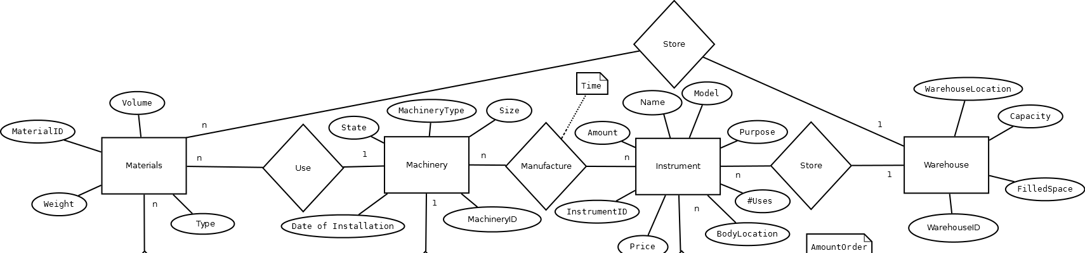

Materials

Slide 10


Instruments
Warehouse
INSTRUMENT
ID Instrument | Model | Purpose | Amount | # Uses | Body Location | Price | Warehouse Location
1 | Version1 | Cut | 5 | 500 | General | $12 | Chamberi Street nº6
2 | Version2 | Clean | 6 | 1 | General | $5 | Oxfordi Street nº55
3 | Version1 | Absorb | 7 | 200 | Stomach | $200 | Alcala Street nº16
WAREHOUSE
WarehouseID | Capacity | Warehouse Location | Filled Space
1 | 20 m^3 | Chamberi Street nº6 | 2 m^3

Slide 11
THANK YOU QUESTIONS?

